Slide 1


Slide 2




Objective of Land Polling
Identify what problems and under what circumstances they can apply LP/LR;
Understand how LP/LR works in both theory and practice;
Set realistic goals for LP/LR projects from the perspectives of different stakeholders;
Design and execute the implementation processes such as assessing and mitigating risks and developing grievance redress mechanisms; and
Anticipate possible unintended outcomes and evaluate LP/LR projects.

Slide 3



What is Land pooling?
Land pooling is an activity where a group of landowners handover their land parcels to the government collectively for infrastructure development.
Once the development is complete, the land is handed over to the original owners, after deducting some portion as the cost for the same.

Slide 4

LAND POOLING/RECONSTITUTION MECHANISMS
The world population living in the urban areas is expected to increase to 70 percent from the present 50 percent by the middle of this century.
Land assembly strategy for development projects is known in different parts of the world by different names.
Land readjustment (LR) in South Korea And Japan.

Slide 5
LAND POOLING/RECONSTITUTION MECHANISMS
LAND POOLING/RECONSTITUTION MECHANISMS
Land consolidation in Europe and
Land pooling in Australia & India.

Slide 6
BENEFITS OF LAND POOLING/READJUSTMENT
❖Landowners:
→Increase in Value of land
→ Non-Displacing Strategy of
Land Assembly
→ Conversion of irregular land
parcels into plots of regular
sizes and shapes

Slide 7
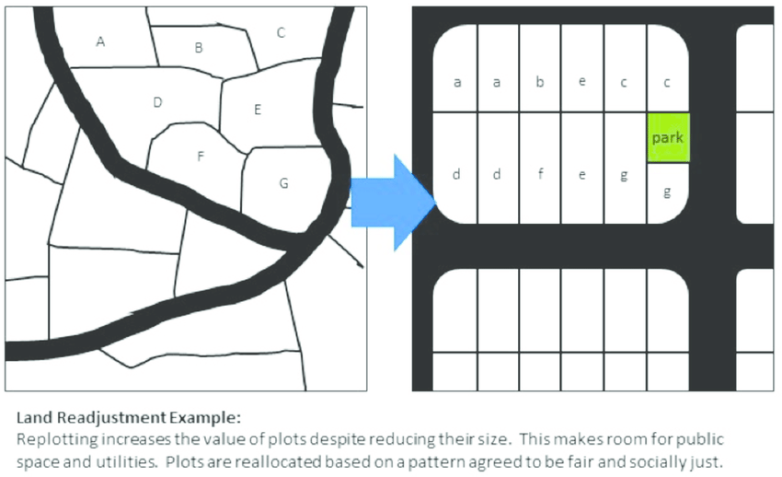
Conversion of irregular to regular

Slide 8
BENEFITS OF LAND POOLING/READJUSTMENT
→ Better Infrastructure
→ Not just the landlords in the area but it could also be a good means of providing entry to land for the lower income housing scheme.

Slide 9
BENEFITS OF LAND POOLING/READJUSTMENT
❖ GOVERNMENT:
→ No Upfront Costs: In the new land acquisition law, the compensation and R & R costs would have to be borne by the land requiring body.
→ Under land pooling, The landowners and development entity share in the risk and return of the project.
→ Relatively less Conflict Ridden Process

Slide 10
BENEFITS OF LAND POOLING/READJUSTMENT
→ Higher tax base with increase in property prices: As explained above, the revenuebase of the local bodies increase owing to increased land values and enlarged tax base.
→ The increased tax revenues provides an extra source of funding for the government.

Slide 11
BENEFITS OF LAND POOLING/READJUSTMENT
❖ Others:
→ Social Capital Creation.
→ Increase of public-private
cooperation and trust.

Slide 12
DISADVANTAGES OF LAND POOLING/READJUSTMENT
Method is time consuming.
Betterment charges are assessed at the beginning of the land pooling or readjustment scheme preparation.
Due to the inordinate delays in finalizing schemes, the betterment charges levied on finalization of the scheme do not meet the cost of the infrastructure provided.

Slide 13
GERMAN MODEL OF LAND POOLING (READJUSTMENT)
Germany has the oldest example of land readjustment (LR).
Has two standards of distribution For readjusted land returned to landowners-
1. RELATIVE SIZE
2.RELATIVE VALUE.

Slide 14
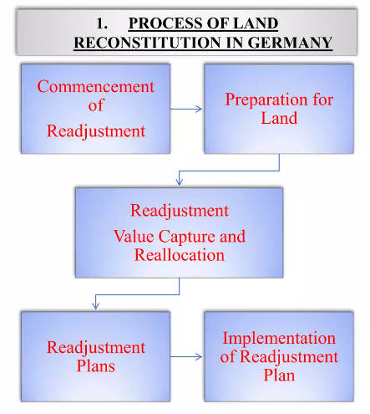
GERMAN MODEL OF LAND POOLING (READJUSTMENT)

Slide 15
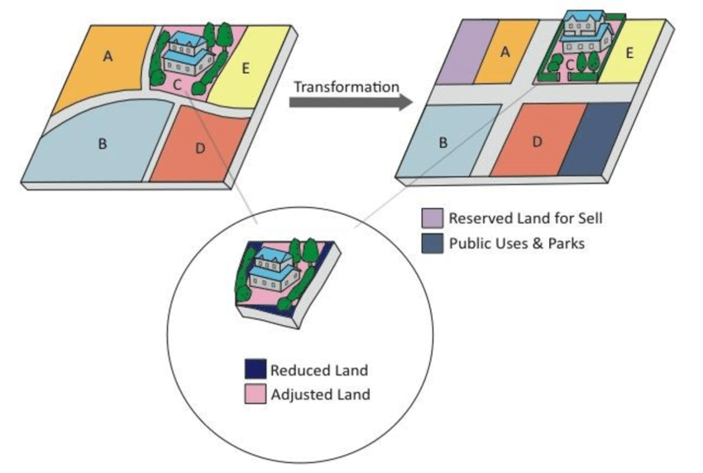
Example of GERMAN MODEL OF LAND POOLING

Slide 16
THE INDIAN LAND POOLING MODELS
In India, the Town Panning Scheme (TPS) was first introduced under the Bombay Town Planning Act (TPA) of 1915.
The first TPS was prepared for seven acres in Bandra (Deuskar, 2011).
There are important differences in the different land pooling policies with regard to the standards governing returnable plots to landowners.
The minimum land size that can be pooled also varies with a minimum in Raipur to a maximum in Delhi (two hectares and 10 hectares respectively).

Slide 17
THE INDIAN LAND POOLING MODELS
THE GUJARAT PLAN-TOWN PLANNING SCHEME, 1976
The Legislation:
In Gujarat, the first TPA was implemented in 1915 & modified in 1954.
The recent version of the Act is the Gujarat Town Planning and Urban Development Act(GTPUDA), 1976.
The legislation provides for the development of decadal macro level "Development Plan" for the entire city and
followed by a large number of micro level TPSS of 100 ha area each.
The Act was amended in 1999 to enable the local Government to take the possession of land for construction of roads after approval of the draft TPS.

Slide 18

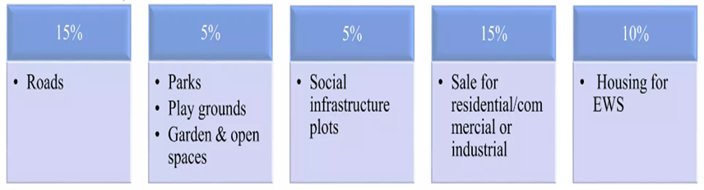
THE INDIAN LAND POOLING MODELS
The allotment of land in the TPS is:
The remaining land is to be reconstituted and returned to the land owners.

Slide 19
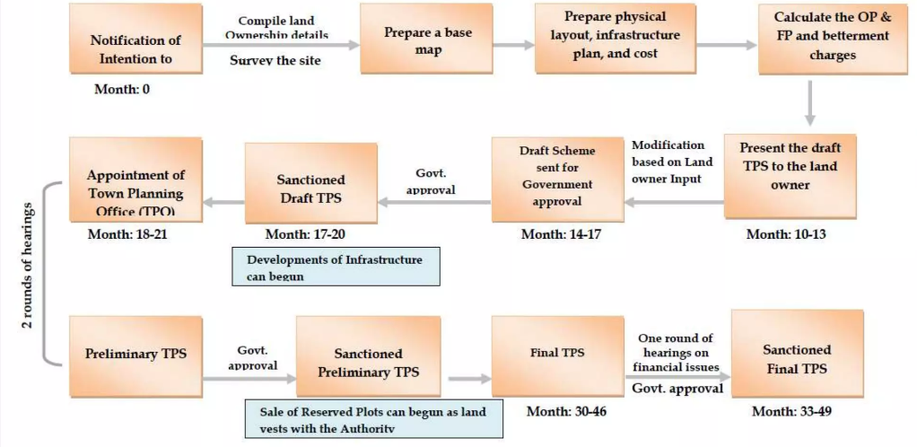
THE INDIAN LAND POOLING MODELS

Slide 20
Preparation of TPS
The process for preparing a TPS is prescribed in GTPUDA, 1976, and its Rules.
Survey of the Area
Establishing the Ownership Details of Every Land Parcel
Reconciling the Survey and Landownership Records to Prepare a Base Map.
Defining the Boundary of the Area.
Marking Original Plots on the Base Map.
Tabulating Ownership Details and Plot Size.
Laying Out the Roads in the Area.

Slide 21
Preparation of TPS
Carving Out Plots for Amenities in the Area.
Tabulating Deduction and Final Plot Size.
Delineation of Final Plots.
Tabulating Infrastructure and Betterment Charges.
Owner's Meeting.
Modification of the Draft TPS and its Approval.
Appointment of the Town Planning Officer (TPO)
Finalization of the Final TPS, Its Approval, and Implementation.

Slide 22
Future land pooling Application in Bangladesh
Land pooling is not practiced in Bangladesh.
At present some application is seen on a small scale in the new buildup area of the divisional city.
As private development agencies sometimes use.
It is possible to improve the living facilities of the people in the populated areas in Bangladesh through land pooling.
Application of land pooling in Bangladesh is very difficult because they know very little about land pooling.
They do not feel safe transfer land form development authorities

Slide 23


